Slide 1
Shot Noise in Lithography
Morgan Williamson
Physics Department
Tsoi Spintronics Lab

Slide 2
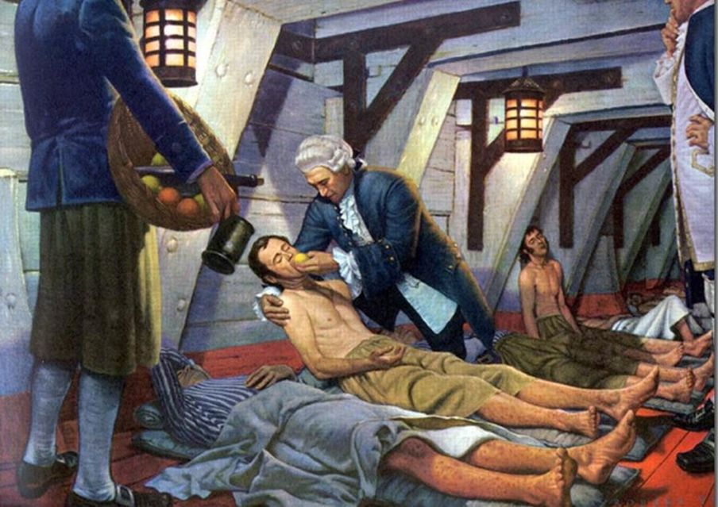
The “Noise” in Shot Noise
J. W. Waterhouse
“Noise” derives from the word nausea
“the noise made by an ancient shipful of passengers groaning and vomiting in bad weather.”
Eric Partridge, Lexicographer 1958
Robert Thom

Slide 3
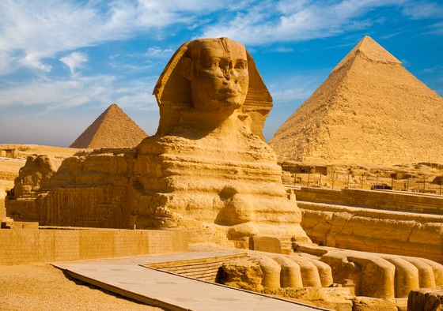
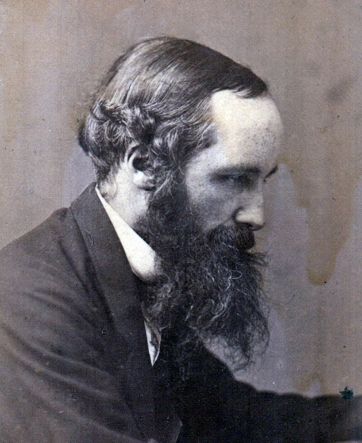
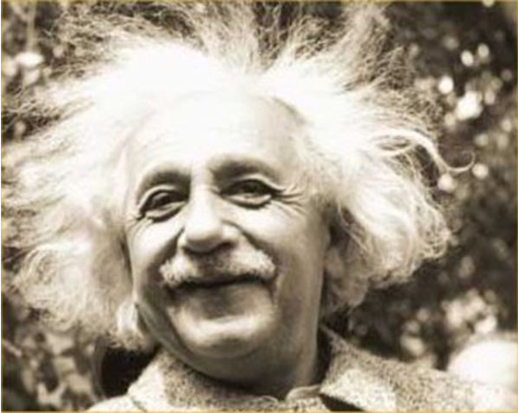
“Prehistory”
Brownian Motion 1827
Maxwell-Boltzmann 1859
Einstein 1905
Diffusion ← Brownian Motion
Photoelectric Effect
Stage is set for:
Discrete matter and discrete energy

Slide 4
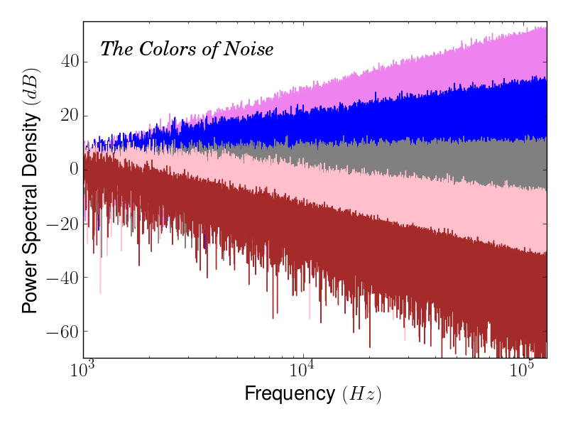
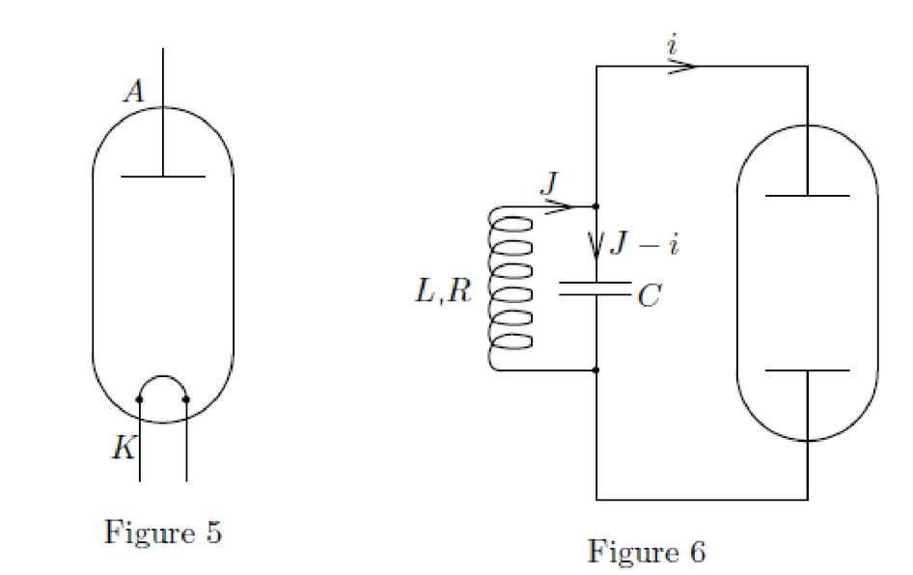
The “Shot” in Shot Noise
Shot noise is due to the discrete nature of charge carriers, and arises since any charge transfer involves an integral number of charge carriers
Shot Noise: The series of independent random events of the passage of charge carriers across barriers.
“Schroteffekt” 1918
Walter Schottky
Study of vacuum diodes at low current
Power Law Noise:
1/f ^{β}
Violet Noise: β = -2
Blue Noise: β = -1
White Noise: β = 0
Pink Noise: β = 1
Red Noise: β = 2
Vacuum Diode
Vacuum Diode RLC Circuit

Slide 5
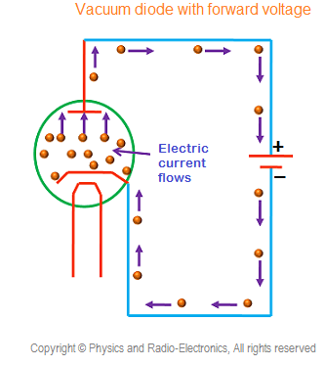
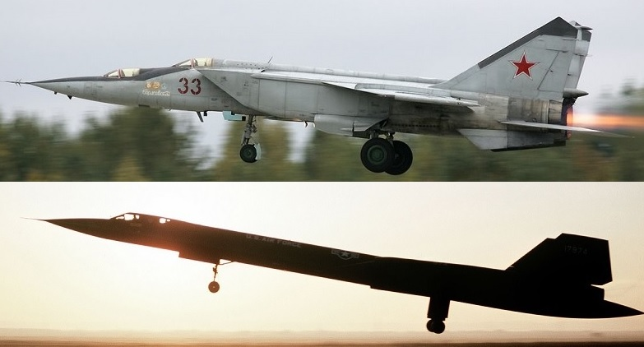
Vacuum Diode
Principle of Operation:
Exploitation of broken symmetry of charge carriers
Anode
Anode
Cathode
Cathode
“Not as a continuously flowing current but as a hail of charge quanta”
Schottky

Slide 6
Shot noise in cameras
Shot noise
Granular noise
Poisson noise
Photon noise
Crank up the ISO

Slide 7
Shot noise in astronomy
Shot noise
Granular noise
Poisson noise
Photon noise
Crank up the ISO

Slide 9
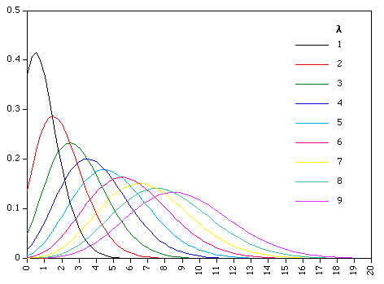
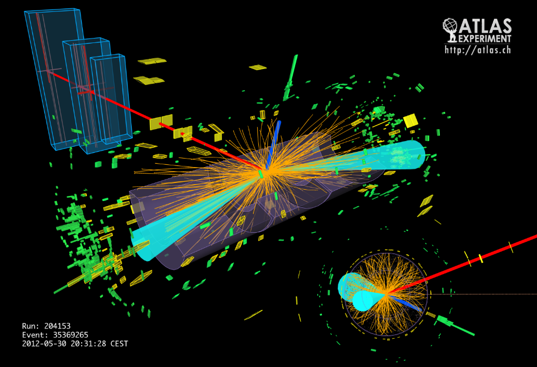
Poisson Statistics
$\sqrt{λ}$ is the standard deviation

Slide 10
Resolution: Image vs Energy
1030 x 772
30 x 40
Image
Resolution
Energy
Resolution
Dose Energy
N*(ħν)
Dose Energy
N*(ħν)

Slide 11
Resolution: Image vs Energy
1030 x 772
30 x 40
Image Resolution
= $\frac{Image length}{Pixel size}$
Energy Resolution
Dose Energy
N*(ħν)
Dose Energy
N*(ħν)
Particle Energy
(ħν)
Particle Energy
(ħν)
= $\frac{Dose Energy}{Particle Energy}$

Slide 12
How to make energy resolution worse…
Lower Dose Energy
Dose Energy
N*(ħν)
Dose Energy
N*(ħν)
Particle Energy
(ħν)
Particle Energy
(ħν)
Dose Energy
N*(ħν)
Dose Energy
N*(ħν)
Increase Particle Energy
Particle Energy
(ħν)
Particle Energy
(ħν)

Slide 13
Particle Number → Energy Resolution
,
,

Slide 14
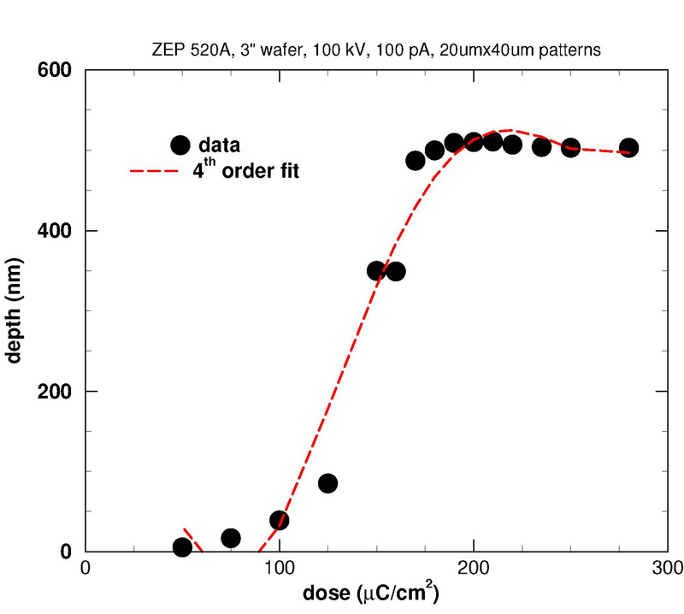
Resist Behavior
100%
Polymerized
$$\frac{1}{10}dose \left({μC}/{{cm}^{2}}\right)$$
$$=dose \left({mJ}/{{cm}^{2}}\right)$$
x axis (micrometer)
→ Line Edge Roughness
Which would you choose?

Slide 15
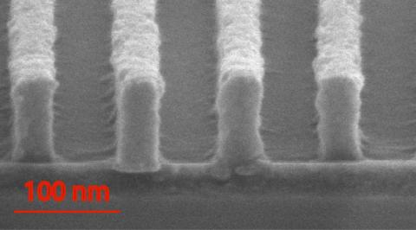
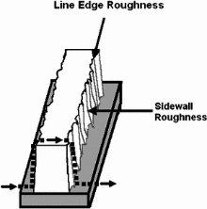
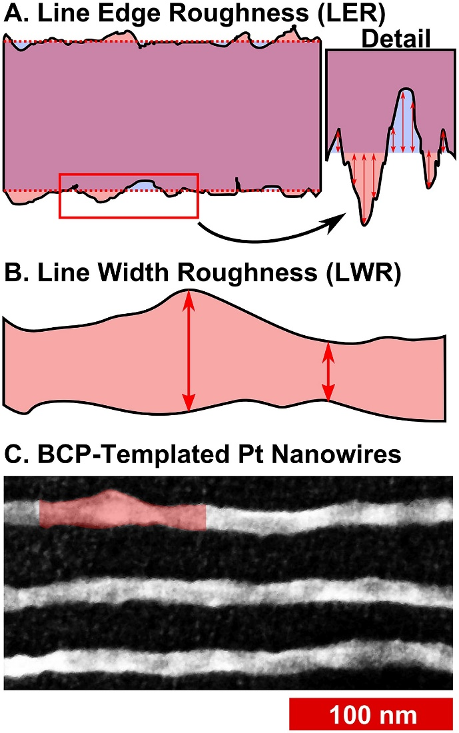
Line Edge Roughness (LER)

Slide 16
“Prolith”
“MetroLER”

Slide 17
Photon to acid simulation results

Slide 18
Simulation to Experiment

Slide 19
Trickier than just σ

Slide 20
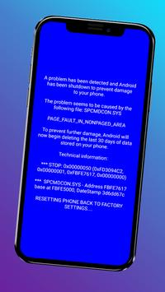
Printing Failures

Slide 21
Questions?

Slide 22
More Information
Papers in SPIE
Shot noise: A 100 year history, with applications to lithography, C. Mack
Statistical simulation of resist at EUV and ArF, M. Smith et al.
A Simple Model of Line-Edge Roughness, C. Mack
Mechanistic simulation of line-edge roughness, J Biafore
Line-edge roughness and the ultimate limits of lithography, C. Mack
Statistical simulation of resist at EUV and ArF, J Biafore et al.
Resist fundamentals for resolution, LER, and sensitivity (RLS) performance tradeoffs and their relation to micro-bridging defects, B. Rathsack et al.
Impact of stochastic effects on EUV printability limits, P. De Bisschop et al.
Quantification of shot noise contributions to contact hole local CD nonuniformity, R. Gronheid et al.
Stochastic effects in EUV lithography: random, local CD variability, and printing failures, P. De Bisschop
Application of stochastic modeling to resist optimization problems, J. Biafore et al.
Reducing roughness in extreme ultraviolet lithography, C. Mack
Inside PROLITHTM, C. Mack
Pattern prediction in EUV resists
Books
Electronics Noise and Signal Recovery, E. R. Davies
Noise: Sources, Characterization, Measurement, A. Van Der Ziel
Electronic Noise and Interfering Signals Principles and Applications, G. Vasilescu

